Slide 1
Natural Log Model Building
ECON 6010 Statistical Methods
Dr. Fadi Fawaz
Department of Economics and Finance
Tennessee State University©

Slide 2
Natural Log Model Building
Use quadratic terms in a regression model – for nonlinear in variable models
Use transformed variables in a regression model
Measure the correlation among the independent variables – the problem of collinearity among independent variables

Slide 3
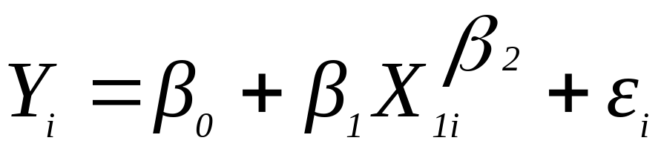
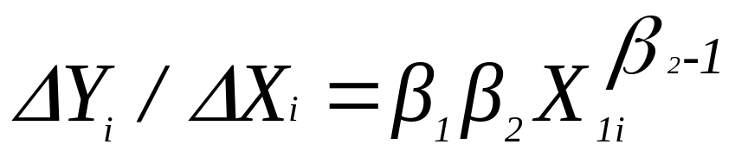
Nonlinear Relationships
There are two possible nonlinearity problem:
A. Nonlinear in coefficient (parameters) – cannot be transformed and estimated by OLS methods. Requires Maximum Likelihood nonlinear estimation.
  The estimated coefficients are nonlinear

Slide 4
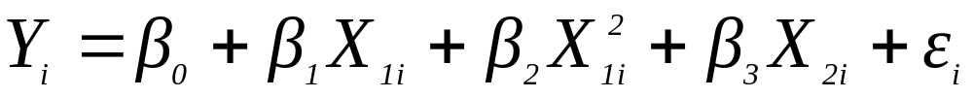
Nonlinear Relationships, Continued
Nonlinear in independent variable:
  If incorrect (linear) form is used, then estimated coefficients, and, thus, predictions and extrapolations are incorrect.
  Can review the scatter diagram to check for non-linear relationships
Examples:
Quadratic model-- The second independent variable is the square of the first variable

Slide 5
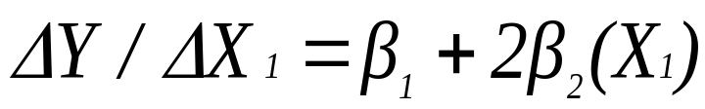
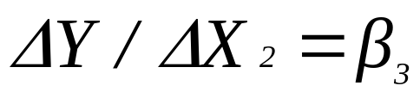
where:
β₀ = Y intercept
β₁ = regression coefficient for linear effect of X on Y
β₂ = regression coefficient for quadratic effect on Y
ε_{i} = random error in Y for observation i
The slope relationship between Y and X₁ changes as X₁ changes. The slope of X₂ is constant. That is:

Slide 6
β₁ = the coefficient of the linear term
β₂ = the coefficient of the squared term
Holding X₂ constant, the relationship between Y and X₁ are:
Average Cost Curve
Wage-experience relationship
Y
Y
X₁
X₁
β₁ > 0
β₁ < 0
β₂ > 0
β₂ < 0

Slide 7
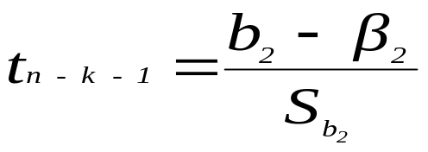
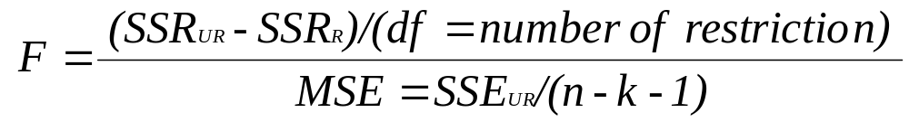
Testing for Significance:
Testing for Quadratic term only
Testing the Overall Quadratic Model (test for overall relationship
The test
H₀: β₂ = 0 The quadratic term doest not improve the model
H₁: β₂ ≠ 0 The quadratic term improves the model
  H₀: β₁ = β₂ = 0 (no overall relationship between X and Y)
  H₁: β₁ and/or β₂ ≠ 0 (there is a relationship between X and Y)

Slide 8
2. Other non-linear Models: Using Transformations in regression Analysis
Idea:
non-linear models can often be transformed to a linear form
  Can be estimated by least squares if transformed
transform X or Y or both to get a better fit or to deal with violations of regression assumptions
Can be based on theory, logic or scatter diagrams (curve fitting, should be avoided if possible)

Slide 9
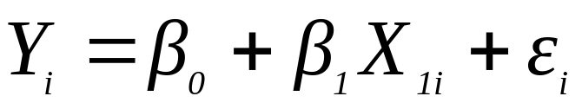
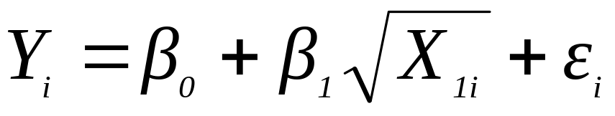
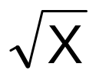
The Square Root Transformation
The square-root transformation
Used to
  overcome violations of the homoscedasticity assumption
  fit a non-linear relationship
Y
Y
b₁ > 0
X

Slide 10
b. The Log Transformations
Variables enter Multiplicatively rather than additively
Depending on the sign of β₁
Y
β₁ > 0
Y
0<β₁<1
β₁ < 0
X₁
X₁
The Original Models, holding X₂ constant
Scales of X, Y, or both are changed

Slide 11



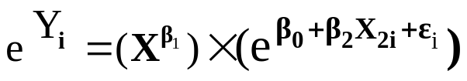

Functional forms
  A Log-Linear Model
    or
  An Exponential Model
  A Semi-Log Model

Slide 12


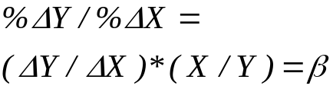


Summary
Model | Dep. | Ind. | Coefficient | Interpretations
Linear | Y | X |  | Constant slope
Quadratic | Y | X, X² |  | Slope changes with X
Log-Linear | Ln Y | Ln X |  | Slope is elasticity
Exponential | Ln Y | X | Growth Model | % Change in Y from an absolute change in X
Semi-log | Y | Ln X | % Change in Money supply effects on GNP by $ | Absolute change in mean of Y from % change in X

Slide 13
Collinearity
When high correlation exists among two or more independent variables
      This means the correlated variables contribute redundant information to the multiple regression model
Including two highly correlated explanatory variables can adversely affect the regression results
  No new information provided
  Can lead to unstable coefficients (large standard error and low t-values)
  Coefficient signs may not match prior expectations

Slide 14
Some Indications of Strong Collinearity
  Incorrect signs on the coefficients
  Large change in the value of a previous coefficient when a new variable is added to the model
  A previously significant variable becomes insignificant when a new independent variable is added
  The estimate of the standard deviation of the model increases when a variable is added to the model

Slide 15
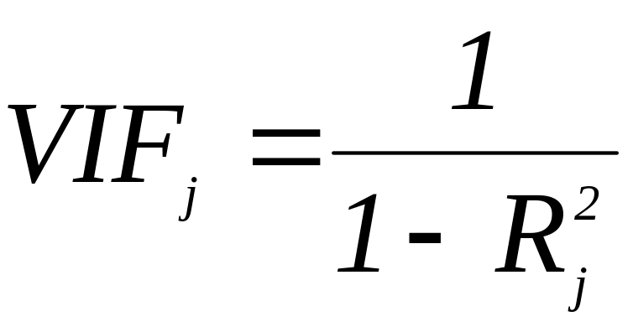
Detecting Collinearity (Variance Inflationary Factor)
VIF is used to measure collinearity:
where R²_{j} is the coefficient of determination of variable X_{j} with all other X variables
If VIF_{j} > 5, X_{j} is highly correlated with the other explanatory variables

Slide 16
Model Building
Goal is to develop a model with the best set of independent variables
    Easier to interpret if unimportant variables are removed
    Lower probability of collinearity
Two approaches – Stepwise and Best Sub-Sets
Stepwise Regressions -- develop the least squares regression equation in steps, adding one explanatory variable at a time and evaluating whether existing variables should remain or be removed (Provide evaluation of alternative models). There are three procedures:
    1. Backward Elimination
    2. Forward Selection
    3. Stepwise procedure

Slide 17

Stepwise Approaches:
Backward Elimination:
  Starts with all independent variables included (a multiple regression)
  Finds the variable with smallest partial F statistic value (or t-statistic value) and test for H₀: =0
  If this null hypothesis is rejected, then the null hypothesis is rejected for all other variables (since all other partial f statistic values are higher than the one with the smallest). In this case, the process stops and the model with all variables is chosen as the model.
  If the null hypothesis is not rejected, then the variable in question is deleted from the model and a new regression is run with one less variable. The process is repeated until a null hypothesis is rejected, and a final model is chosen.

Slide 18
Forward Selection
  Have a set of independent variables. Starts with separate simple regression for each of the independent variables
  Finds the variable with largest partial F statistic value (or t-statistic value) and test for H₀: =0
  If this null hypothesis is NOT rejected, then the null hypothesis cannot be rejected for any other variable (since all other partial F statistic values are smaller than the one with the largest). In this case, the process stops. You don’t have a model. Start rethinking your logic.
  If the null hypothesis is rejected, then the variable in question is judged important and kept. Next each of the remaining variable is added (separately) to the regression that already has the first independent variable. The variable with the highest Partial F statistic value is added. The process continues. When no more variables are judged to have nonzero coefficient, the procedure stops and the final model is determined.

Slide 19
Stepwise Procedure
  This procedure combines elements of both backward and forward. It starts like the forward approach:
  Starts with separate simple regression for each of the independent variables. Finds the variable with largest partial F statistic value (or t-statistic value) and test for H₀: =0
  If the null hypothesis is rejected, then the variable in question is judged important and kept. Next each of the remaining variable is added (separately) to the regression that already has the first independent variable. The variable with the highest Partial F statistic value is added. Now we have a two-variable model. At this point, the stepwise starts acting like backward. That is after adding the second variable, it tests for the importance of the first variable.
  Each variable can enter at one step, deleted in another step and reentered in yet another step.

Slide 20
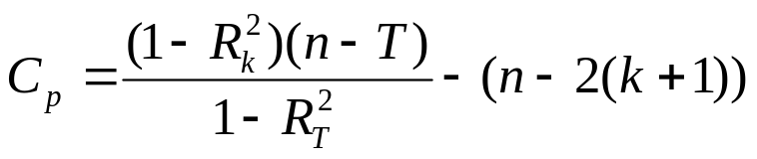
Best-subset approach
Best-subset approach -- estimate all possible regression equations using all possible combinations of independent variables
Try all combinations and select the best using
  the highest adjusted r² and lowest standard error, OR
  The C_{p} Statistic
Where k = number of independent variables included in a particular regression model
T = total number of parameters to be estimated in the full regression model
R_{k}² = coefficient of multiple determination for model with k independent variables
R_{T}² = coefficient of multiple determination for full model with all “T” estimated parameters

Slide 21
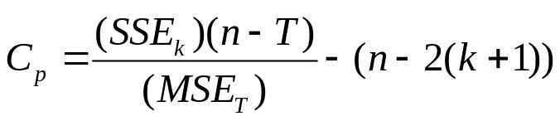
C_{p} formula can be shown to be also equal to:
The best model are those with C_{p} values that are small and close to K+1.
Question:
  Which variable selection method is the best? Backward? Forward? General Stepwise? Or The Best-Subset?
  The best-Subset is the best because it examines every possible model (if computer time and capacity is not a concern)

Slide 22
Summary of Model Building
Steps:
  1. Choose independent variables to include in the model
  2. Estimate full model and check VIFs
  3. If no VIF > 5, then perform best subsets regression with all variables; List all models with C_{p} close to or less than (k + 1); Choose the best model; Consider parsimony ( Do extra variables make sense and make a significant contribution?); Perform complete analysis with chosen model, including residual analysis; check for linearity and violations of other assumptions
  4. If one or more VIF > 5, remove them from the model; Re-estimate the new model with the remaining variables, and repeat step 4.

